Slide 1
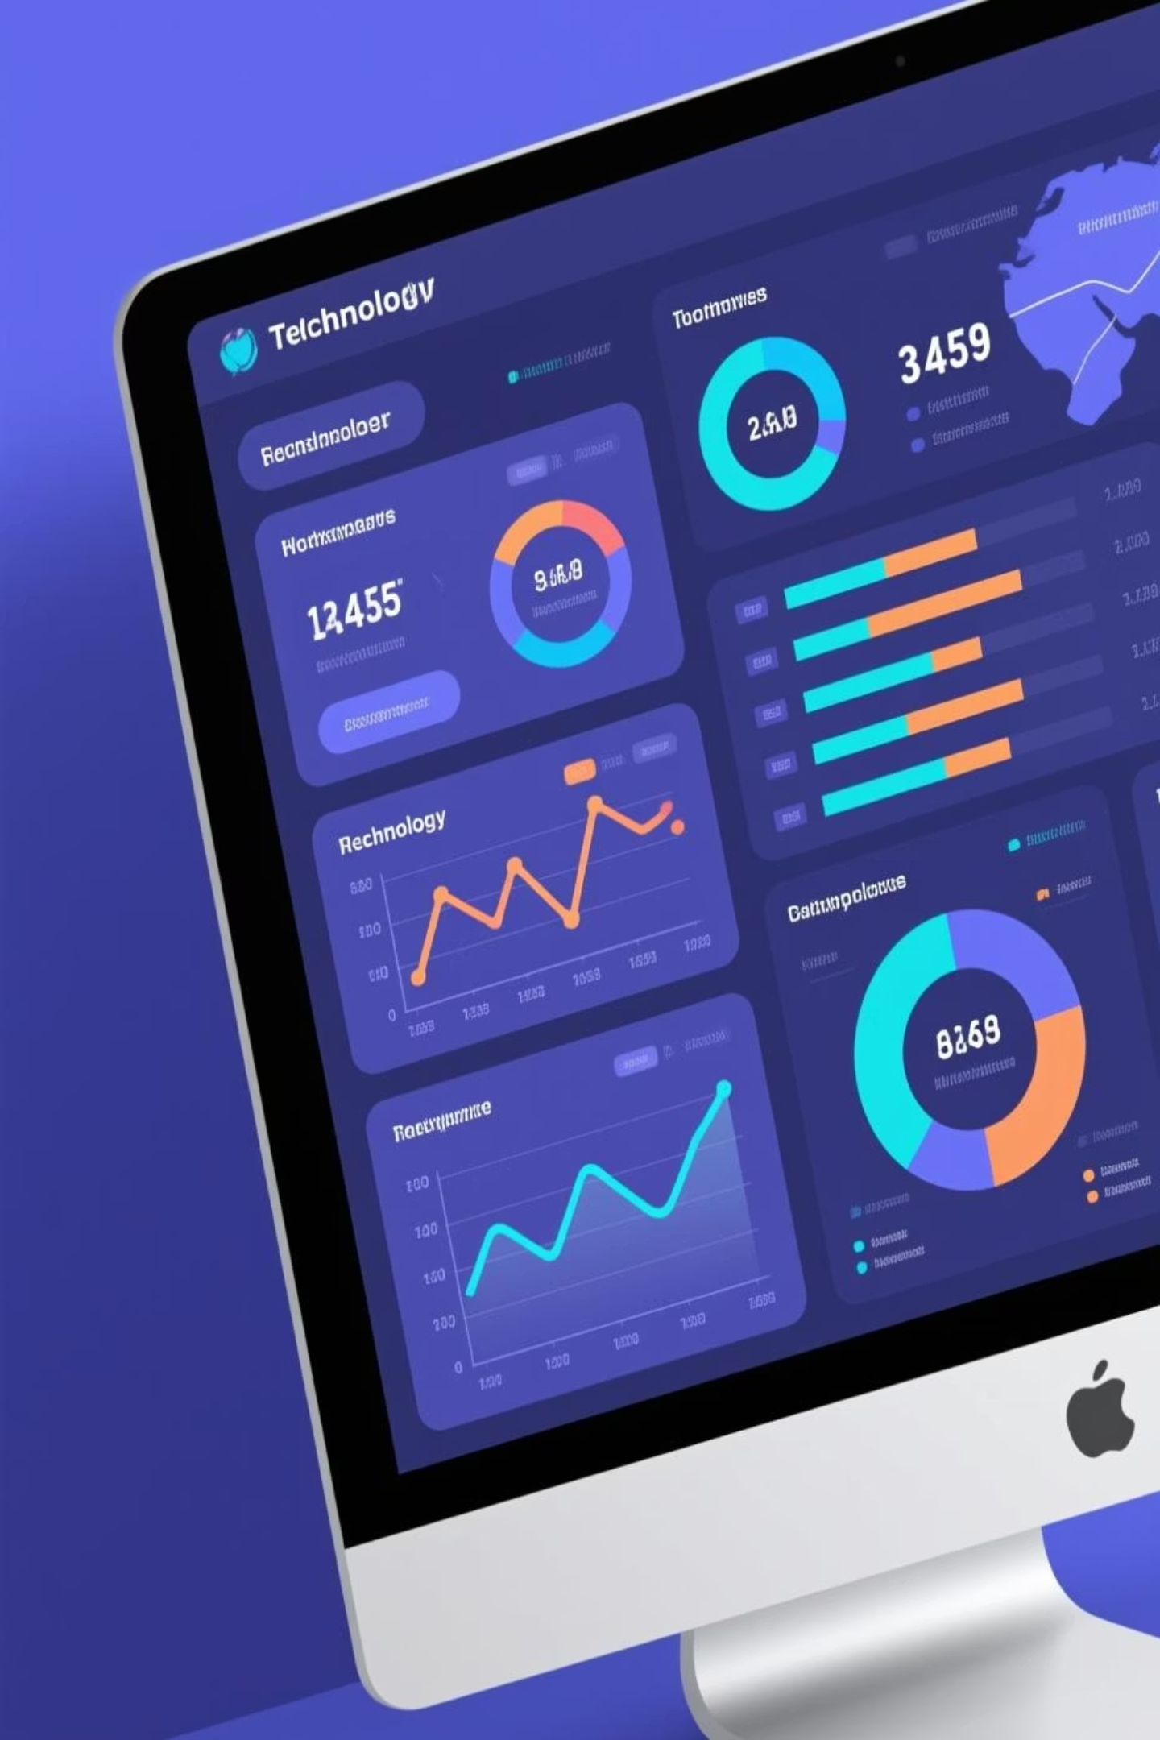
FDD — Financial Due Dilligence
Team: Zayaan S Byramji 22WU0101114 Sathvika Kakarapalli 22WU0101091
Mentor: Venkata Satya Madhav Medicherla

Slide 2

Problem Statement & Business Need
The Challenge
Our Solution
Manual financial file analysis is slow, error-prone, and increasingly untenable at scale. Organizations struggle with:
A production-ready platform that automates KPI extraction from heterogeneous financial files, surfacing key metrics with LLM-driven narratives and intelligent alerts.
Time-consuming manual data extraction processes
Inconsistent interpretation across teams
Impact: Reduced time-to-insight, lower operational risk, and comprehensive audit support.
Lack of automated audit trails
Delayed insights for critical decisions

Slide 3
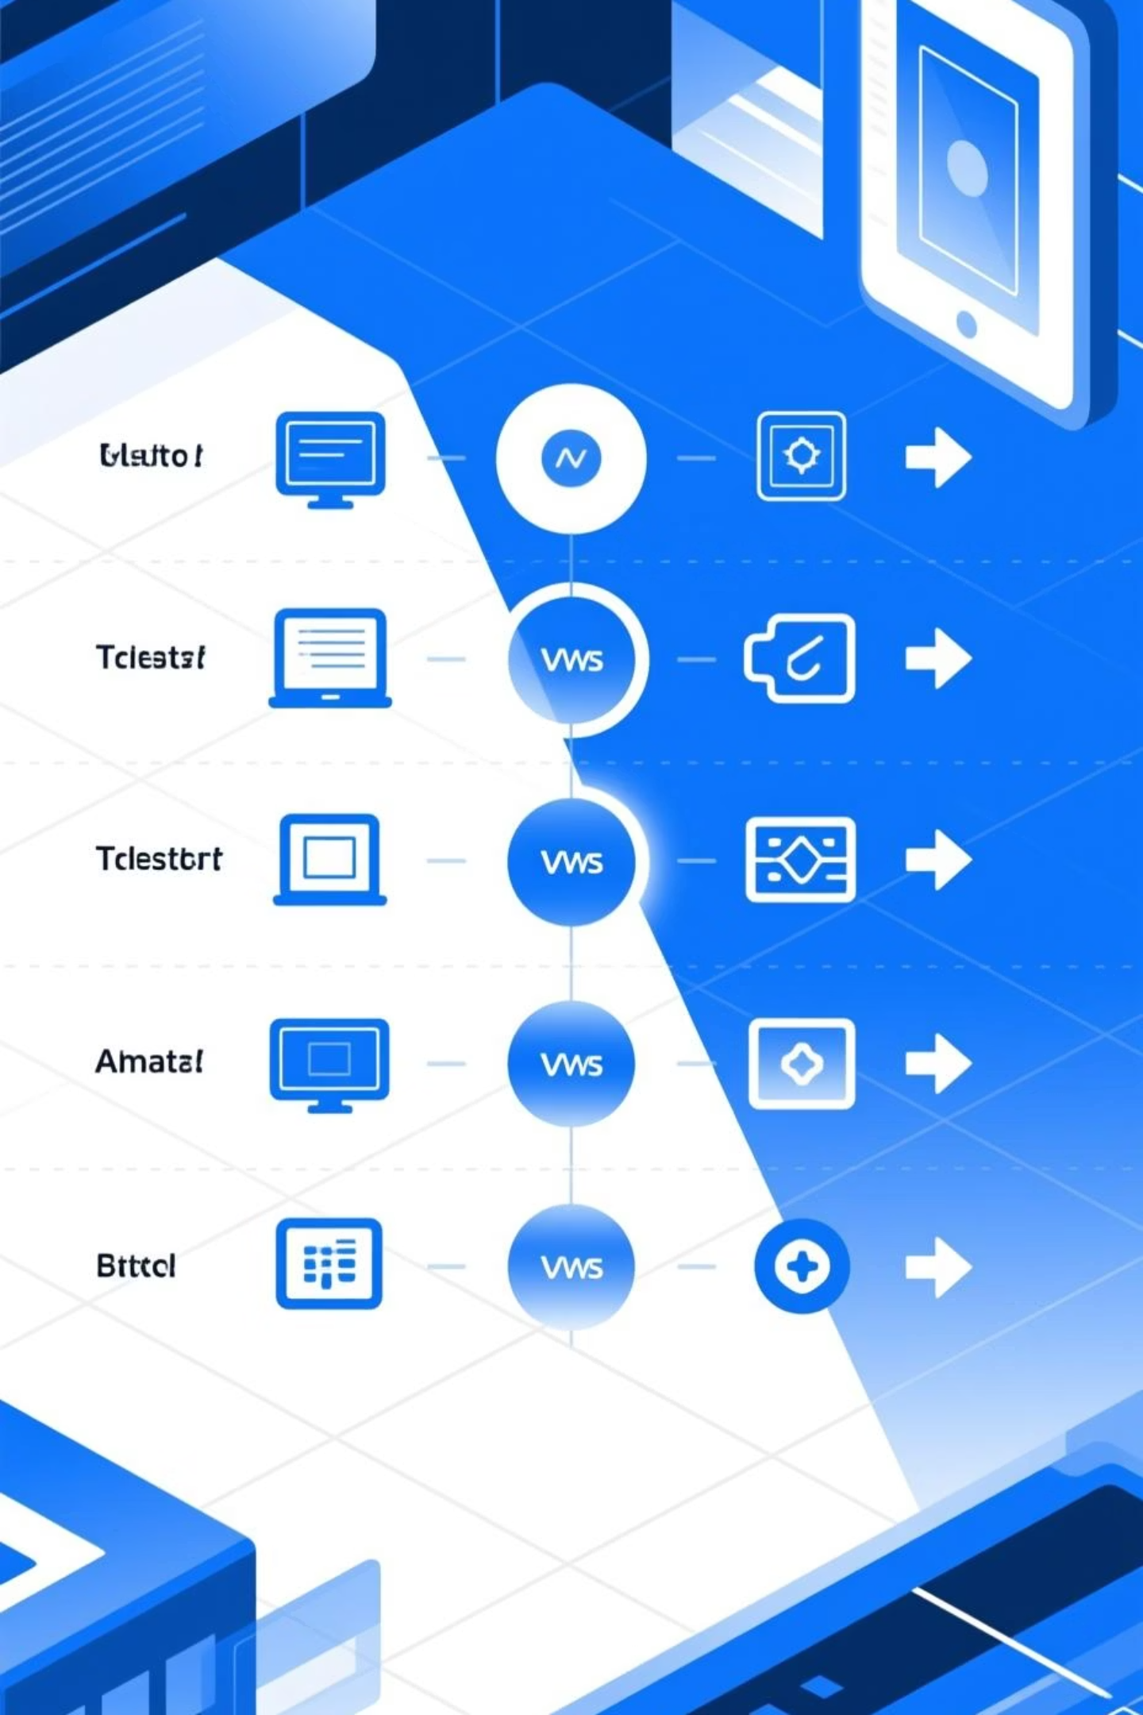
Technology Review & Competitive Advantage
Existing Approaches
Key Limitations
Traditional BI tools with manual configuration
Brittle ingestion for mixed file formats
ETL frameworks requiring extensive coding
Limited reproducibility and auditability
LLM proof-of-concepts lacking production rigour
Costly and opaque LLM usage patterns
Our Advantage
Hybrid deterministic + LLM parsing
Validated output with audit trails
Cost-aware orchestration and monitoring

Slide 4

Objectives, Success Criteria & Scope
01
02
Core Objectives
Defined Scope
Deliver accurate KPI extraction with explainable LLM narratives, production deployment with comprehensive monitoring, and enterprise-grade security controls.
Frontend UI, backend API, ML microservice, CI/CD pipeline.

Slide 5




System Architecture & Data Flow
Three-Tier Production Design
React UI Layer
Vite-powered frontend with responsive design, real-time status updates, and intuitive report visualisation.
Node/TypeScript API
Express-based backend handling authentication, job orchestration, validation, and RESTful endpoints.
ML Microservice
FastAPI service with vector DB integration, LLM orchestration, and deterministic fallback mechanisms.
Resilience features: Job queue with retry logic, health probes at every layer, circuit breakers, and graceful degradation to deterministic parsing when LLM services are unavailable.

Slide 6
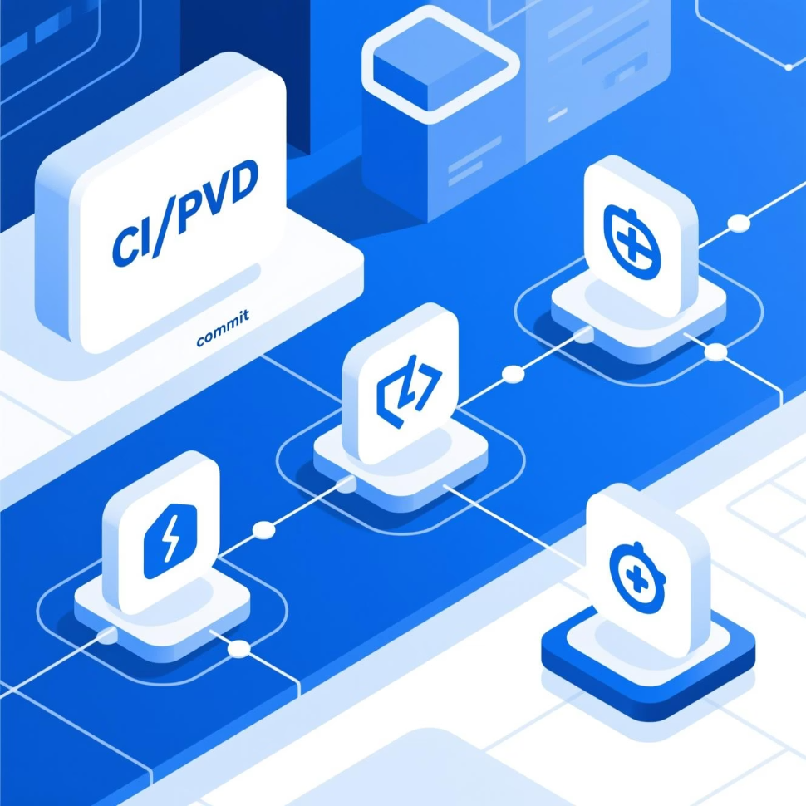
Implementation & CI/CD Pipeline
Technology Stack
Frontend: React with Vite, TypeScript, TailwindCSS
Backend: Express.js, TypeScript, Node.js runtime
ML Service: FastAPI, Python, FAISS/managed vector DB
Storage: PostgreSQL, S3-compatible object storage
Continuous Integration
GitHub Actions enforces quality gates: linting, unit tests, type checking, container builds, security scanning (SAST/SCA), and automated Helm deployments.
Build
Package
Lint, test, type-check
Container build
1
2
3
4
Scan
Deploy
Security analysis

Slide 7
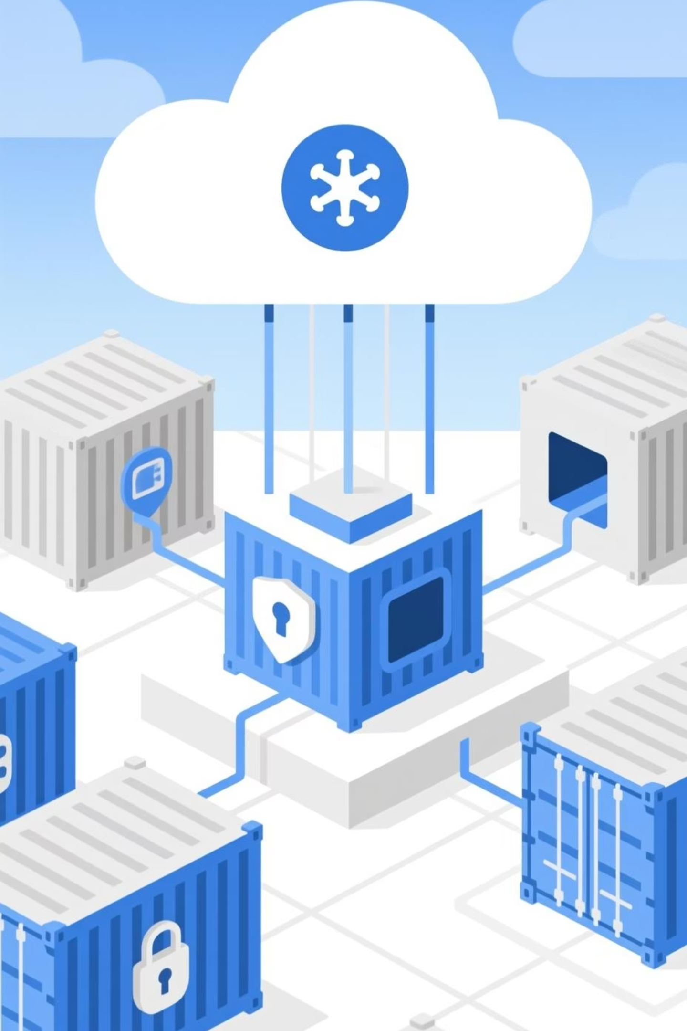

Containerisation, Orchestration & Security
Container Strategy
Multi-stage Docker builds optimise image size and security. Images are signed, scanned for vulnerabilities, and pushed to a private registry with immutable tags.
Kubernetes Orchestration
Helm charts manage deployments with horizontal pod autoscaling, liveness/readiness probes, resource quotas, and network policies for zero-trust networking.
Security Controls
OAuth2 authentication, mTLS between services, KMS/Secrets Manager for sensitive data, least-privilege IAM roles, and TLS encryption for all traffic.

Slide 8
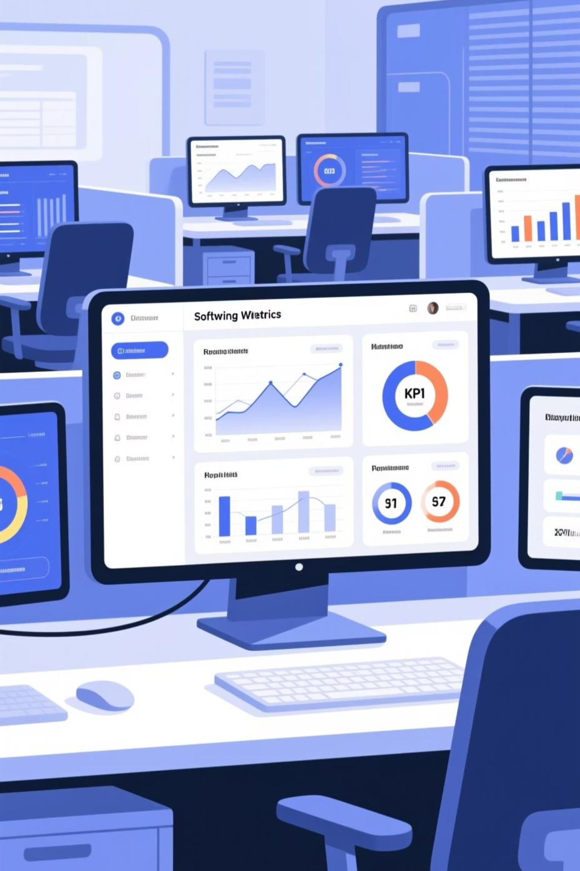


Observability, Testing
Comprehensive Observability
Prometheus metrics collection, Grafana dashboards for real-time monitoring, OpenTelemetry distributed tracing
Multi-Layer Testing
Unit tests with Jest, integration tests for API contracts, end-to-end tests using Playwright, load testing with k6, and synthetic canary checks in production.

Slide 9

Innovation & Conclusion
Key Innovations
Production-Ready Delivery
1
Hybrid Parsing Architecture
We've built a robust, scalable pipeline that delivers reliable KPI extraction with explainable AI-driven analysis, comprehensive observability, and enterprise-grade security.
Combines deterministic extraction with LLM intelligence for optimal accuracy and cost efficiency.
Future Roadmap
Multi-tenancy with isolated data planes
2
JSON-First LLM Orchestration
Real-time streaming ingestion for continuous monitoring
Structured output validation ensures consistency and enables comprehensive audit trails.
Fine-tuning models on domain-specific corpora
Enhanced RBAC with granular permissions
3
Cost Controls & Observability
Real-time monitoring of LLM spend with configurable budgets and automatic fallback mechanisms.

Slide 10
Team Contributions & Demo Guide
Individual Contributions
Frontend Development
Backend & API
React component architecture and state management
RESTful API design and implementation
Report visualisation and real-time updates
Job orchestration and queue management
Responsive UI/UX design implementation
Authentication and authorization flows
ML & Data Pipeline
DevOps & Infrastructure
LLM integration and prompt engineering
CI/CD pipeline configuration
Vector database implementation
Kubernetes cluster management
Deterministic parser development
Observability stack deployment

